Slide 1
SALIENT FEATURES OF THE INDIAN CONSTITUTION
Tushar Gangadhare -2324000227
Electrical Engineering Department
KIT’s College of Engineering (Autonomous), Kolhapur

Slide 2
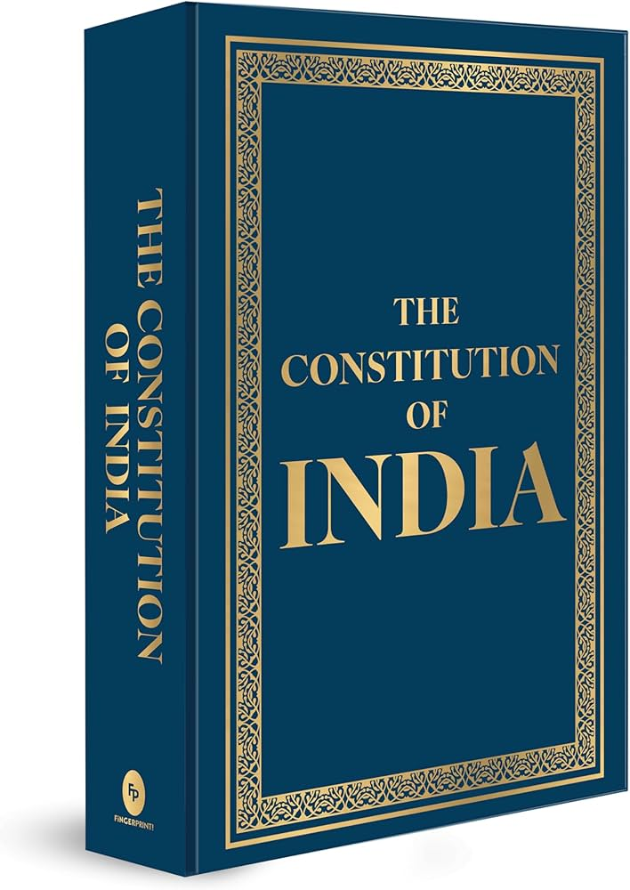
Introduction
The Constitution of India is the supreme law of the land. It lays down the framework for political principles, structure, powers, and duties of government institutions and citizens. Adopted on 26th November 1949 and enforced on 26th January 1950, it reflects the aspirations and values of the Indian people.
This presentation highlights the key features that make the Indian Constitution unique, comprehensive, and dynamic, helping to govern the world’s largest democracy.

Slide 3
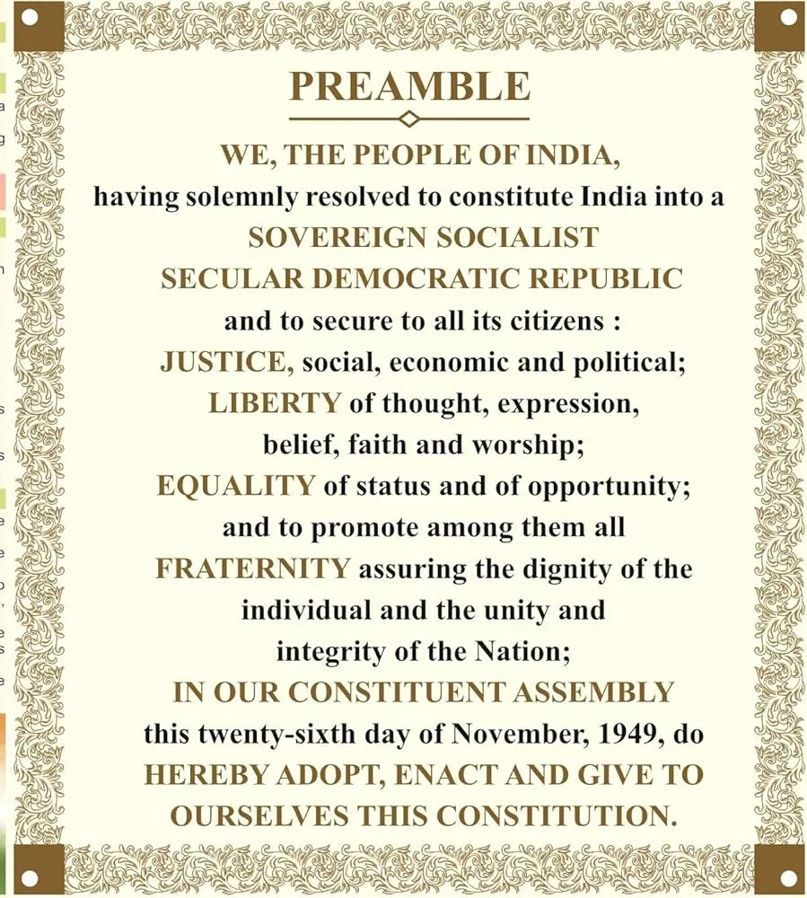
The Preamble – Key Words & Their Meanings
1. Sovereign India is independent and not under the control of any external power. It has the freedom to make its own laws and decisions.
2. Socialist India strives to reduce economic inequality and provide equal opportunity to all, ensuring social justice.
3. Secular The State has no official religion. All religions are treated equally and with respect.
4. Democratic The government is elected by the people, and every citizen has the right to vote and participate in governance.
5. Republic India has an elected head of state (the President), not a hereditary monarch.
6. Justice Social, economic, and political fairness and equality for all citizens.
7. Liberty Freedom of thought, expression, belief, faith, and worship.
8. Equality All citizens are equal before the law; no one is above or below.
9. Fraternity A spirit of brotherhood among all Indians, ensuring unity and dignity of the individual and the nation.

Slide 4

Federal System with Unitary Bias
1. Federal Structure: India has a division of powers between the Central Government and State Governments, as defined in the Constitution (Union List, State List, and Concurrent List).
2. Unitary Features in Practice:
In times of emergency, the Constitution becomes unitary – all powers shift to the Centre.
Governor (appointed by Centre) has significant powers in states.
Single Constitution for the entire country (except J&K before 2019).
Integrated Judiciary with the Supreme Court at the top.
3. Why the Bias? To maintain national unity, integrity, and strong governance in a diverse country like India with many cultures, languages, and regions.

Slide 5
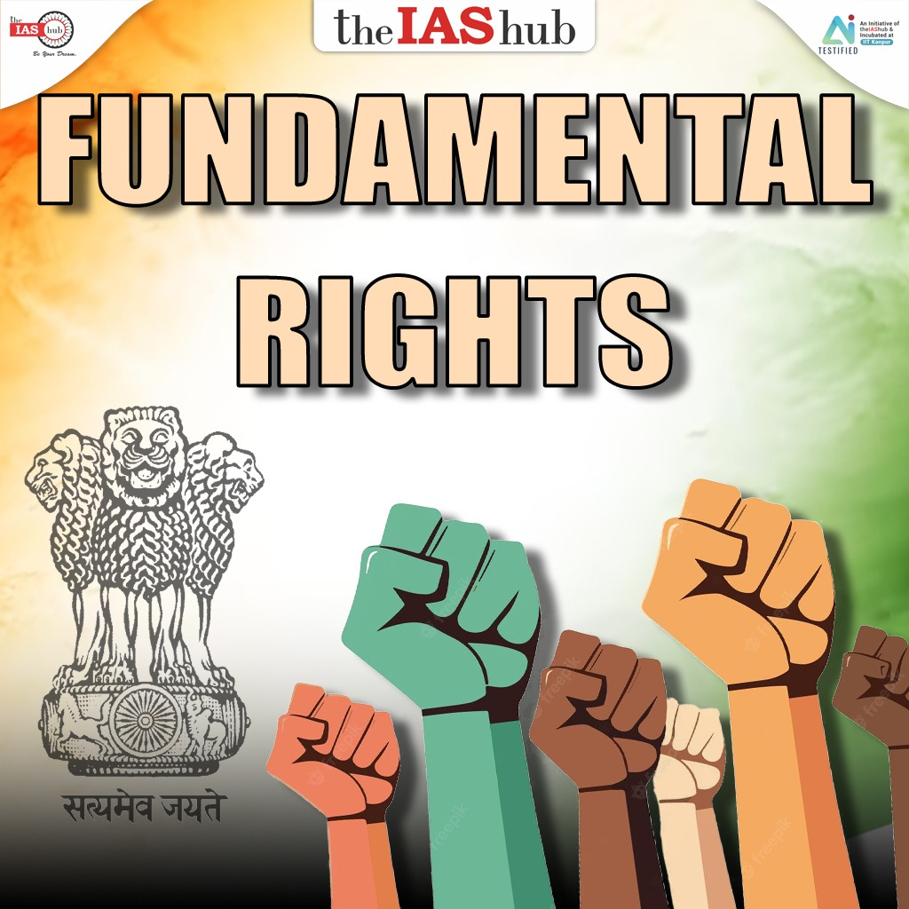
Fundamental Rights
The Six Fundamental Rights:
1. Right to Equality (Articles 14–18)
Equality before the law
Prohibition of discrimination
Equality of opportunity in public employment
2. Right to Freedom (Articles 19–22)
Freedom of speech and expression
Freedom of assembly, association, movement, residence, and profession
Protection in respect of conviction and personal liberty
3. Right against Exploitation (Articles 23–24)
Prohibits human trafficking, forced labor, and child labor
4. Right to Freedom of Religion (Articles 25–28)
Freedom to profess, practice, and propagate any religion
5. Cultural and Educational Rights (Articles 29–30)
Protection of the rights of minorities to conserve their culture
Right to establish and administer educational institutions
6. Right to Constitutional Remedies (Article 32)
Right to move the Supreme Court to enforce Fundamental Rights
Called the "Heart and Soul" of the Constitution – Dr. B.R. Ambedkar

Slide 6

Judicial Review
What is Judicial Review? Judicial Review is the power of the Judiciary (especially the Supreme Court and High Courts) to examine the constitutionality of laws and executive actions.
Key Points:
1. Guardian of the Constitution:
Ensures that laws made by the legislature and actions taken by the executive do not violate the Constitution.
2. Declaring Laws Invalid:
If any law or order is found unconstitutional, the judiciary can strike it down.
3. Protecting Fundamental Rights:
Acts as a watchdog to protect the rights and liberties of citizens.
4. Inspired by the U.S. Constitution:
Adopted and adapted from the American concept of judicial review.
5. Article 13:
Clearly states that any law inconsistent with Fundamental Rights is null and void.

Slide 7
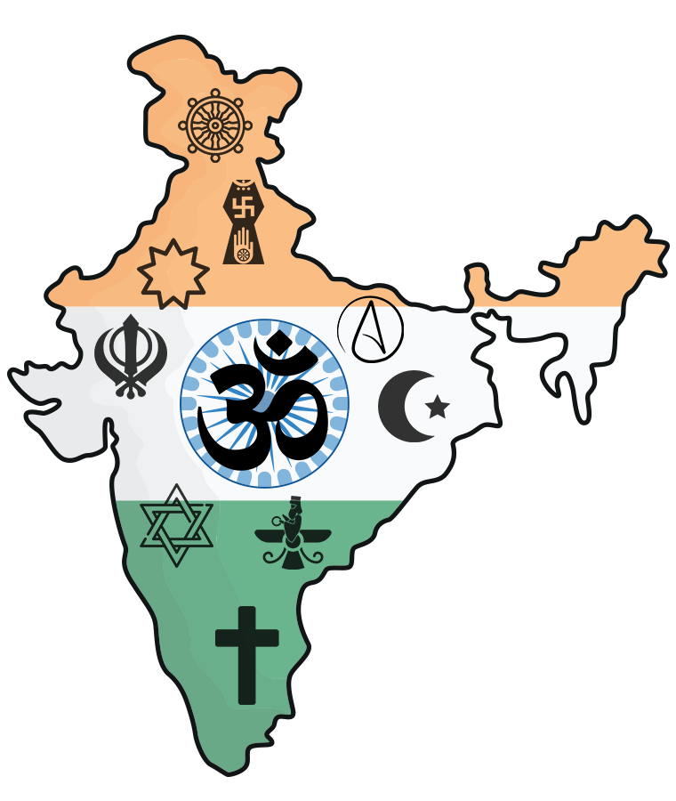
Secularism
What is Secularism? Secularism means that the State has no official religion and treats all religions equally. It ensures freedom of religion and religious harmony.
Key Features of Indian Secularism:
1. Equal Respect for All Religions:
The government does not favor or discriminate against any religion.
2. Freedom of Religion (Articles 25–28):
Citizens have the right to profess, practice, and propagate their religion.
3. No Religious Interference in State Affairs:
Religion is separate from political power.
The State functions independently of religious institutions.
4. Cultural Freedom:
Every individual and community is free to preserve their culture and traditions.
5. Promotes Unity in Diversity:
Encourages peaceful coexistence in India’s multi-religious society.

Slide 8
Conclusion
The Indian Constitution is a visionary document that lays the foundation for the world’s largest democracy. Its salient features – such as federalism, secularism, fundamental rights, judicial review, and a parliamentary system – ensure justice, liberty, equality, and fraternity for all citizens.
It is a living document, capable of evolving with time while upholding the core values of the nation. Let us all respect and uphold the Constitution, as it is not just a legal framework, but a guiding light for our democracy.
REFERENCES:
IMAGES:GOOGLE
CONTENT: https://chatgpt.com/share/6807ba42-1d1c-8007-8bd3-02f61743b7b1

